Slide 1
Spam Classification Using
Natural Language Processing
Presented by: Paranthaman P
au2151330088
TPGIT

Slide 2
OUTLINE:
Problem Statement
Proposed Solution
System Requirement
Software Requirement
Algorithm & Deployment
Result
Reference

Slide 3
Problem Statement:
Spam classification using NLP is a technique that uses Natural Language Processing (NLP) to classify emails or messages as spam or not spam. The technique involves analyzing the text of the message and extracting features that can help identify whether the message is spam or not. These features can include the presence of certain words or phrases, the length of the message, the use of capital letters, and other characteristics. The extracted features are then used to train a machine learning model that can classify new messages as spam or not spam. This technique is widely used in email filtering systems and messaging applications to prevent unwanted messages from reaching the user's inbox.

Slide 4
Proposed Solution:
Get Data and Clean It:
Collect messages that are labeled as either spam or not spam.
Clean the messages by removing unnecessary stuff like numbers and special characters, and make all text lowercase.
Understand Words:
Figure out which words are important in the messages.
Count how often each word appears in the messages.
Teach a Computer:
Teach a computer program to recognize spam based on the words it sees.
Show it lots of examples of messages and tell it whether they're spam or not spam.

Slide 5
Check Its Work:
Test the program with new messages it hasn't seen before.
See if it can correctly tell if they're spam or not spam.
Make It Better:
Adjust the program to make it better at recognizing spam.
Keep testing and improving it until it works well.
Put It to Work:
Use the program to automatically filter out spam messages from your inbox.
Enjoy a cleaner inbox without having to deal with spam!

Slide 6
System Requirements:
Operating System:
Any modern operating system such as Windows, macOS, or Linux can be used.
Hardware:
CPU: A multi-core processor (Intel Core i5 or equivalent) is recommended for better performance.
RAM: At least 8GB of RAM is recommended. More RAM may be necessary for larger datasets and complex models.
Storage: Sufficient disk space for storing datasets, model files, and other project-related files. SSD storage is preferable for faster data access.

Slide 7
An internet connection is required for downloading datasets, pre-trained models, and libraries. Additionally, it may be necessary for accessing cloud-based resources or APIs for certain functionalities.
Internet Connection:
Software Requirements:
Python:
Most NLP libraries are built for Python, so having Python installed (version 3.6 or higher) is necessary.
NLP Libraries:
Install necessary libraries such as NLTK, spaCy, Transformers, and Gensim using package managers like pip or conda.

Slide 8
Development Environment:
Use an Integrated Development Environment (IDE) like PyCharm, Jupyter Notebook, or Visual Studio Code for coding and experimentation.
Algorithm & Deployment:
Algorithm:
Data Preparation:
Collect a dataset of labeled emails or messages, with each message tagged as spam or not spam (ham).
Preprocessing:
Clean and preprocess the text data. This includes removing special characters, converting text to lowercase, tokenization (breaking text into words or tokens), and removing stopwords (common words like "the", "and", "is" that don't carry much meaning).

Slide 9
Deployment:
Model Serialization:
Serialize (save) the trained model to disk so that it can be loaded and used later without retraining.
Building an Interface:
Develop an interface (e.g., a web application, API) where users can input messages to be classified as spam or not spam.
Integration:
Integrate the serialized model into the interface/application code

Slide 10
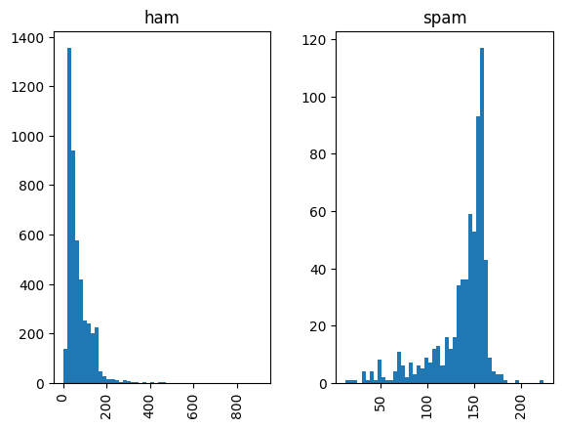
Result:

Slide 11
Reference:
Pandas:
Official Website: pandas.pydata.org
Documentation: pandas.pydata.org/docs/
SciPy:
Official Website: scipy.org
Documentation: docs.scipy.org/doc/scipy/reference/
NLTK (Natural Language Toolkit):
Official Website: www.nltk.org
Documentation: www.nltk.org/api/nltk.html

